Slide 1
CS 106A, Lecture 15 Events and Memory

Slide 2




HW4:
Breakout
Memory
The River of Java
You are here
Events
Animation
Graphics
Programs

Slide 3
Plan for Today
Review: events and instance variables
A Boolean Aside
Memory
Revisiting Whack-A-Mole
Midterm tips

Slide 4
Plan for Today
Review: events and instance variables
A Boolean Aside
Memory
Revisiting Whack-A-Mole
Midterm tips

Slide 5
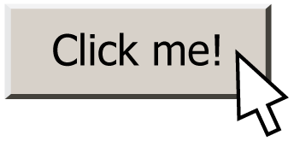
Events
event: Some external stimulus that your program can respond to.
event-driven programming: A coding style (common in graphical programs) where your code is executed in response to user events.

Slide 6
Events
public void run() {
// Java runs this when program launches
}
public void mouseClicked(MouseEvent event) {
// Java runs this when mouse is clicked
}
public void mouseMoved(MouseEvent event) {
// Java runs this when mouse is moved
}
Notes:
these new methods also have to be specifically named.
Just like run, these methods are called by Java, not by our code!

Slide 7
Types of Mouse Events
There are many different types of mouse events.
Each takes the form: public void eventMethodName(MouseEvent event) { ...
Method | Description
mouseMoved | mouse cursor moves
mouseDragged | mouse cursor moves while button is held down
mousePressed | mouse button is pressed down
mouseReleased | mouse button is lifted up
mouseClicked | mouse button is pressed and then released
mouseEntered | mouse cursor enters your program's window
mouseExited | mouse cursor leaves your program's window

Slide 8
MouseEvent Objects
A MouseEvent contains information about the event that just occurred:
Method | Description
e.getX() | the x-coordinate of mouse cursor in the window
e.getY() | the y-coordinate of mouse cursor in the window

Slide 9
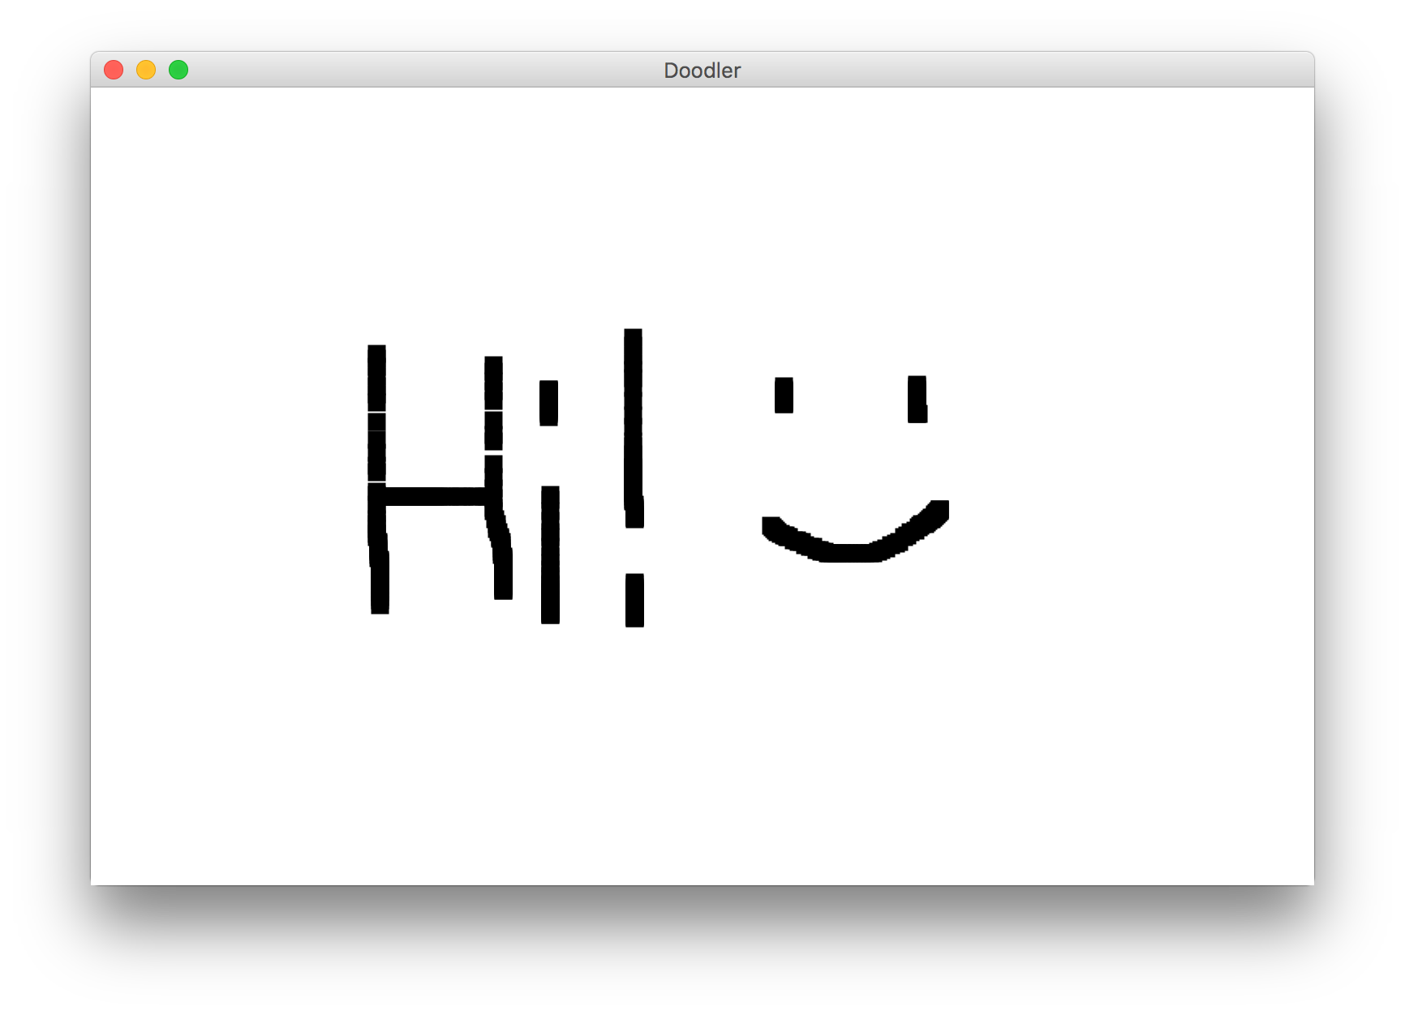
Example: Doodler
Notes:
Uses mouseDragged

Slide 10
Doodler
public void mouseDragged(MouseEvent event) {
double mouseX = event.getX();
double mouseY = event.getY();
double rectX = mouseX – SIZE / 2.0;
double rectY = mouseY – SIZE / 2.0;
GRect rect = new GRect(rectX, rectY, SIZE, SIZE);
rect.setFilled(true);
add(rect);
}
What if we wanted the same GRect to track the mouse, instead of making a new one each time?
Notes:
No way to do this! We can’t pass parameters since we don’t call mouse event methods
No way for information to live between mouse dragged calls – no variables live then!
No way to access information about previous drag

Slide 11
Instance Variables
private type name; // declared outside of any method
Instance variable: A variable that lives outside of any method.
The scope of an instance variable is throughout an entire file (class).
Useful for data that must persist throughout the program, or that cannot be stored as local variables or parameters (event handlers).
It is bad style to overuse instance variables
Notes:
Because they have a large scope, it is considered bad style to use too many instance variables, or to make something an instance variable that could instead be a local variable, parameter, return, etc.

Slide 12
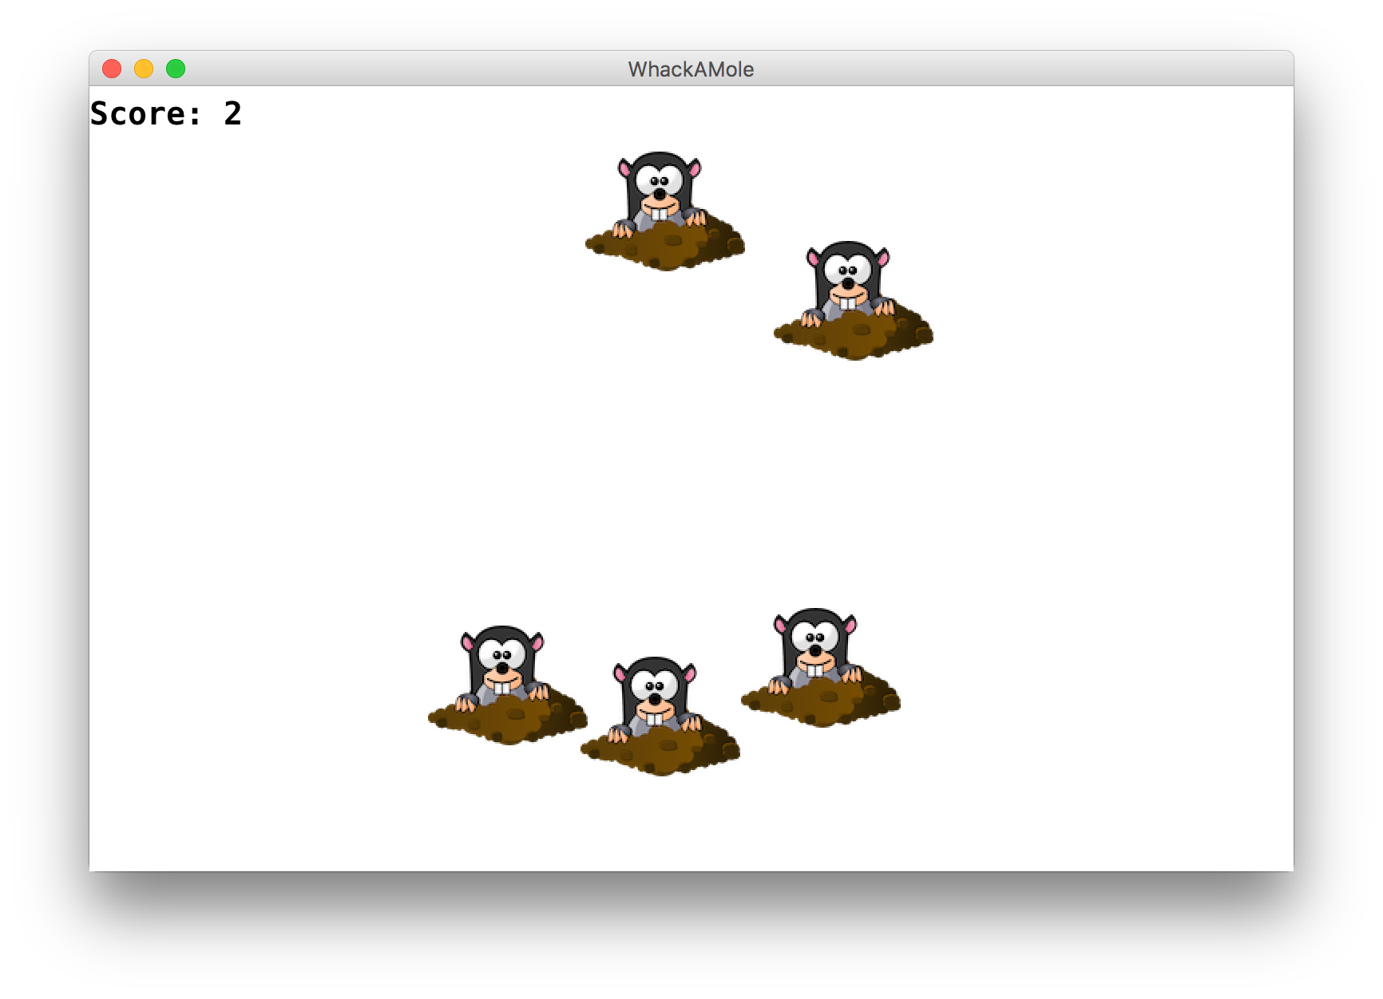
Whack-A-Mole
We used instance variables and events to make Whack-A-Mole!
Notes:
Run: init graphics and adding moles
MouseClicked – remove moles, increment score
Ivars: label and score

Slide 13
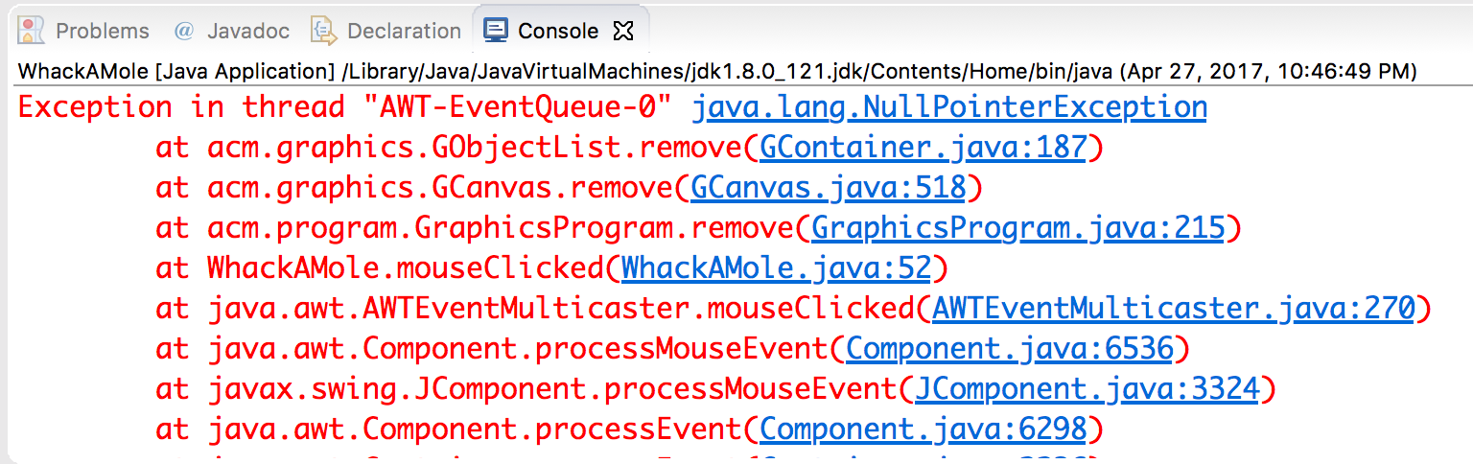
Exception
If the user clicks an area with no mole, the program crashes.
A program crash in Java is called an exception.
When you get an exception, Eclipse shows red error text.
The error text shows the line number where the error occurred.
Why did this error happen?
How can we avoid this?

Slide 14
Whack-A-Null?
public void mouseClicked(MouseEvent event) {
double mouseX = event.getX();
double mouseY = event.getY(); GObject mole = getElementAt(mouseX, mouseY);
remove(mole);
score++;
scoreLabel.setText("Score: " + score);
}
Notes:
1) Returns GObject
What’s the problem here?

Slide 15
Whack-A-Null?
public void mouseClicked(MouseEvent event) {
double mouseX = event.getX();
double mouseY = event.getY(); GObject mole = getElementAt(mouseX, mouseY);
remove(mole);
score++;
scoreLabel.setText("Score: " + score);
}
Problem: mole may be null if the user doesn’t click on a mole! Removing null will crash ☹
Notes:
null is always a problem if you call a method on it, and often a problem if you use it as a parameter to a method (if it doesn’t expect null)

Slide 16
Whack-A-Mole!
public void mouseClicked(MouseEvent event) {
double mouseX = event.getX();
double mouseY = event.getY(); GObject mole = getElementAt(mouseX, mouseY);
if (mole != null) {
remove(mole);
score++;
scoreLabel.setText("Score: " + score);
}
}

Slide 17
Plan for Today
Review: events and instance variables
A Boolean Aside
Memory
Revisiting Whack-A-Mole
Midterm tips

Slide 18
A Boolean Aside
There is one helpful property of how Java evaluates boolean expressions, called short-circuit evaluation.
When evaluating boolean expressions, Java only evaluates as much of the expression as it needs to in order to evaluate it to be true or false.

Slide 19
A Boolean Aside
String str = readLine("? ");
if (str.length() > 0 && str.charAt(0) == 'A') {
...
}

Slide 20
A Boolean Aside
String str = readLine("? "); // what about “”!
if (str.length() > 0 && str.charAt(0) == 'A') {
...
}
Notes:
we can't call charAt(0)--out of bounds

Slide 21
A Boolean Aside
String str = readLine("? "); // what about “”!
if (str.length() > 0 && str.charAt(0) == 'A') {
...
}

Slide 22
A Boolean Aside
String str = readLine("? "); // what about “”!
if (str.length() > 0 && str.charAt(0) == 'A') {
...
}
&& : true if both parts are true
Java only executes the second part if the first part is true! This means it never crashes.

Slide 23
A Boolean Aside
GObject obj = getElementAt(x, y);
if (obj == null || obj.getX() == 0) {
...
}

Slide 24
A Boolean Aside
GObject obj = getElementAt(x, y); // what about null!
if (obj == null || obj.getX() == 0) {
...
}

Slide 25
A Boolean Aside
GObject obj = getElementAt(x, y); // what about null!
if (obj == null || obj.getX() == 0) {
...
}

Slide 26
A Boolean Aside
GObject obj = getElementAt(x, y); // what about null!
if (obj == null || obj.getX() == 0) {
...
}
|| : true if either side is true
Java only executes second part if the first part is false! This means it never crashes.

Slide 27
Plan for Today
Review: events and instance variables
A Boolean Aside
Memory
Revisiting Whack-A-Mole
Midterm tips

Slide 28

By Chris Piech

Slide 29
origin
Nick Troccoli
By Chris Piech

Slide 30
Chapter 1: Birth

Slide 31
Once upon a time…

Slide 32
…a variable x was born!
int x;

Slide 33
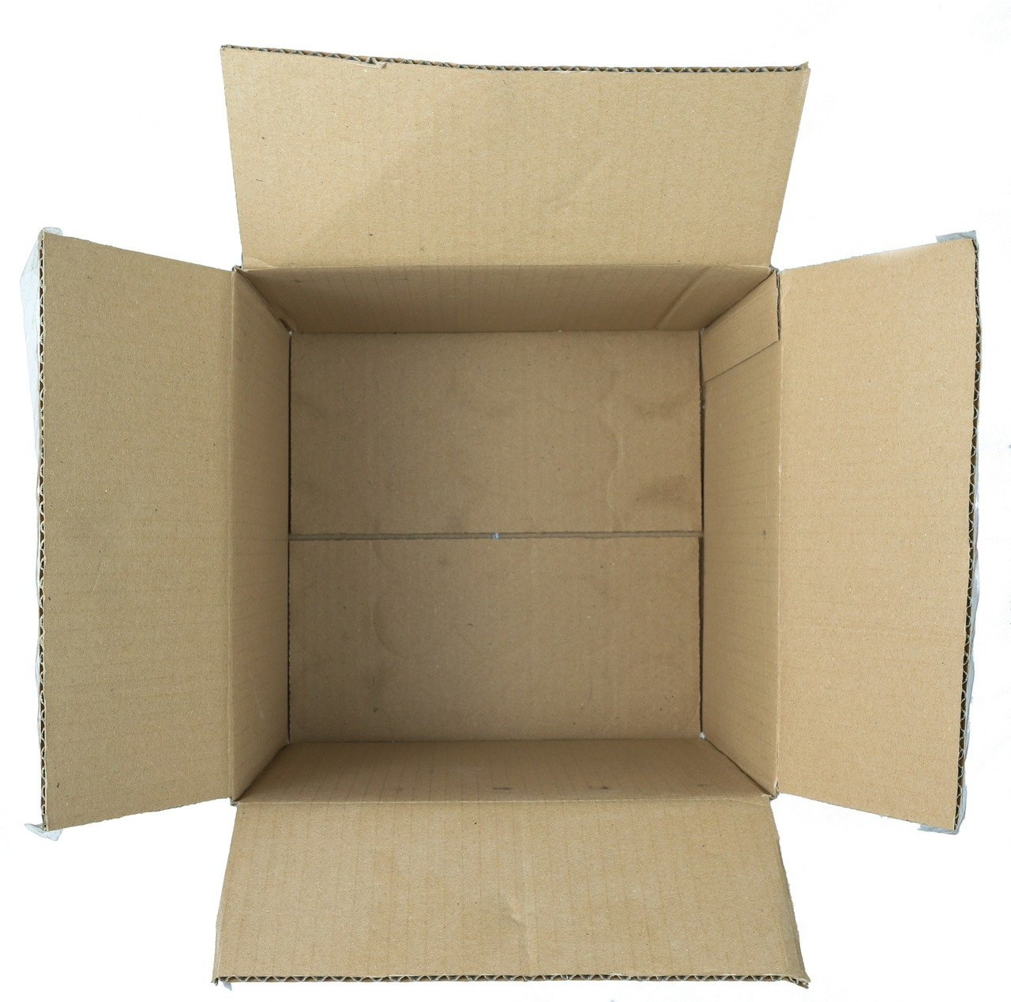
…a variable x was born!
int x;

Slide 34
x was a primitive variable…
int x;
It’s so cuuuute!
Aww…!

Slide 35
…and its parents loved it very much.
int x;
We should give it… value 27!

Slide 36
…and its parents loved it very much.
x = 27;
We should give it… value 27!
27
Notes:
3^3! Excellent number

Slide 37
A few years later, the parents decided to have another variable.

Slide 38
…and a variable rect was born!
GRect rect;

Slide 39
rect was an object variable…
GRect rect;
Who’s a cute GRect???
It’s so square!

Slide 40
…and its parents loved it very much.
GRect rect;
We should make it… a big, strong GRect!

Slide 41
…and its parents loved it very much.
GRect rect = new GRect(0, 0, 50, 50);
We should make it… a big, strong GRect!
Notes:
Right at the origin of their hearts

Slide 42
…but rect’s box was not big enough for an object!
GRect rect = new GRect(0, 0, 50, 50);
That box isn’t big enough to store everything about a GRect!

Slide 43

…so they stored the information in a bigger box somewhere else.
GRect rect = new GRect(0, 0, 50, 50);
x = 0, y = 0
width = 50
height = 50
...
Location 5
See location 5
Notes:
Stack and heap

Slide 44
Chapter 2: Friends

Slide 45
…x makes a new friend!
int y = 27;
x
y
27
27

Slide 46
…x makes a new friend!
int y = 27;
Hi! I’m y.
x
y
27
27

Slide 47
…x makes a new friend!
int y = 27;
We have the same value!
x
y
27
27

Slide 48
…x makes a new friend!
int y = 27;
*blush*
x
y
27
27

Slide 49
They can use == to compare values.
if (x == y) { // true!
...
}
x
y
27
27

Slide 50
They can use == to compare values.
if (x == y) { // true!
...
}
❤️
x
y
27
27

Slide 51
See “A Variable Love Story” for more...

Slide 52
rect also makes a new friend!
GRect r = new GRect(0, 0, 50, 50);
rect
r
See location 5
See location 24
Notes:
Same values! Different location

Slide 53
Rect also makes a new friend!
GRect r = new GRect(0, 0, 50, 50);
Hi! I’m r.
rect
r
See location 5
See location 24

Slide 54
Rect also makes a new friend!
GRect r = new GRect(0, 0, 50, 50);
rect
r
It looks like we have the same coordinates, size, everything!
See location 5
See location 24

Slide 55
Rect also makes a new friend!
GRect r = new GRect(0, 0, 50, 50);
*blush*
rect
r
See location 5
See location 24

Slide 56
But when they use == to compare values...

Slide 57
…something goes wrong.
if (rect == r) { // false!
...
}
rect
r
See location 5
See location 24

Slide 58
…something goes wrong.
if (rect == r) { // false!
...
}
…but… but I thought we had so much in common!
rect
r
See location 5
See location 24

Slide 59
…something goes wrong.
if (rect == r) { // false!
...
}
💔
rect
r
See location 5
See location 24

Slide 60
…something goes wrong.
if (rect == r) { // false!
...
}
You see, == compares what is in each variable’s box.
rect
r
See location 5
See location 24

Slide 61
…something goes wrong.
if (rect == r) { // false!
...
}
Primitives store their actual value in their box.
rect
r
See location 5
See location 24

Slide 62
…something goes wrong.
if (rect == r) { // false!
...
}
But objects store the location where all their information lives.
rect
r
See location 5
See location 24

Slide 63
…something goes wrong.
if (rect == r) { // false!
...
}
This means == on objects compares their locations, which is not what we want here!
rect
r
See location 5
See location 24
Notes:
Will rect and r ever be together?

Slide 64
Chapter 3: Twins

Slide 65
One day, they wanted a twin.
Wow, what an awesome int! Let’s make another one.
x
27
Notes:
X was so perfect, they couldn’t have just one!

Slide 66
One day, they wanted a twin.
Wow, what an awesome int! Let’s make another one.
int x2 = x;
x
27

Slide 67
…so x2 was born!
Wow, what an awesome int! Let’s make another one.
int x2 = x;
x
x2
27
27

Slide 68
…so x2 was born!
But let’s increment this one by 2.
int x2 = x;
x2 += 2;
x
x2
27
29
Notes:
We can’t tell them apart

Slide 69
…so x2 was born!
int x2 = x;
x2 += 2;
Cool, I’m 29 now!
x
x2
27
29

Slide 70
…so x2 was born!
int x2 = x;
x2 += 2;
And I’m still 27!
x
x2
27
29

Slide 71
Then, they wanted a twin for rect, too.
Wow, what an awesome GRect! Let’s make another one.
rect
See location 5

Slide 72
…so rect2 was born!
Wow, what an awesome GRect! Let’s make another one.
GRect rect2 = rect;
rect
See location 5

Slide 73
…so rect2 was born!
Wow, what an awesome GRect! Let’s make another one.
GRect rect2 = rect;
rect
rect2
See location 5
See location 5

Slide 74
…so rect2 was born!
But let’s make this one BLUE.
GRect rect2 = rect;
rect2.setColor(Color.BLUE);
rect
rect2
See location 5
See location 5

Slide 75
…so they went to location 5 and changed the color to blue.
x = 0, y = 0
width = 50
height = 50
Color = BLUE
...
Location 5

Slide 76
But something went wrong…
GRect rect2 = rect;
rect2.setColor(Color.BLUE);
Cool, I’m blue!
rect
rect2
See location 5
See location 5

Slide 77
But something went wrong…
GRect rect2 = rect;
rect2.setColor(Color.BLUE);
Hey, why am I blue TOO?
rect
rect2
See location 5
See location 5

Slide 78
But something went wrong…
You see, when you set one variable equal to another, the value in its box is copied over.
GRect rect2 = rect;
rect2.setColor(Color.BLUE);
rect
rect2
See location 5
See location 5

Slide 79
But something went wrong…
GRect rect2 = rect;
rect2.setColor(Color.BLUE);
For primitive variables, this just means we copy their value.
rect
rect2
See location 5
See location 5

Slide 80
But something went wrong…
GRect rect2 = rect;
rect2.setColor(Color.BLUE);
But for objects, we copy its location instead.
rect
rect2
See location 5
See location 5

Slide 81
But something went wrong…
Therefore, both rect and rect2 think their information is at location 5.
GRect rect2 = rect;
rect2.setColor(Color.BLUE);
rect
rect2
See location 5
See location 5

Slide 82
But something went wrong…
When you change information for an object, you go to its location first, and then update the information.
GRect rect2 = rect;
rect2.setColor(Color.BLUE);
rect
rect2
See location 5
See location 5

Slide 83
But something went wrong…
Since rect and rect2 reference the same location, when you change information for one of them, it changes for both!
GRect rect2 = rect;
rect2.setColor(Color.BLUE);
rect
rect2
See location 5
See location 5

Slide 84
Chapter 4: Leaving the Nest

Slide 85
X grew up, and went to college.
college(x);
Bye everyone! I’m going to college.
x
27

Slide 86
X grew up, and went to college.
college(x);
We’ll miss you, honey! Don’t forget to call! Don’t stay up too late! Watch out for rogue bicyclists!
Bye everyone! I’m going to college.
x
27

Slide 87
X grew up, and went to college.
private void college(int num) {
...
}
run
college
x
num
27
27

Slide 88
x had an amazing college experience…
private void college(int num) {
num = 45;
}
run
college
x
num
27
45

Slide 89
...but ultimately returned home the same.
private void college(int num) {
num = 45;
}
run
college
x
num
27
45

Slide 90
…but ultimately returned home the same.
college(x);
println(x);
I’m baaaaack! And I’m still 27.
x
27

Slide 91
…but ultimately returned home the same.
college(x);
println(x);
I’m baaaaack! And I’m still 27.
Ohhhh honey! You’ll always be our little 27.
x
27

Slide 92
rect grew up too, and also went to college.
college2(rect);
Bye everyone! I’m going to college.
rect
See location 5

Slide 93
rect grew up too, and also went to college.
college2(rect);
Not you too, rect! We are empty nesters now…
Bye everyone! I’m going to college.
rect
See location 5

Slide 94
rect grew up too, and also went to college.
private void college2(GRect box) {
...
}
run
college2
rect
box
See location 5
See location 5

Slide 95
rect also had an amazing college experience…
private void college2(GRect box) {
box.setColor(Color.PINK);
}
run
college2
rect
box
See location 5
See location 5

Slide 96
rect also had an amazing college experience…
x = 0, y = 0
width = 50
height = 50
Color = PINK
...
Location 5

Slide 97
…but it returned home different.
private void college2(GRect box) {
box.setColor(Color.PINK);
}
run
college2
I’m pink!
rect
box
See location 5
See location 5

Slide 98
…but it returned home different.
private void college2(GRect box) {
box.setColor(Color.PINK);
}
Hey, what gives? I’m pink now too!
run
college2
I’m pink!
rect
box
See location 5
See location 5

Slide 99
…but it returned home different.
college(rect);
add(rect);
I’m baaaaack! But now I’m pink…
rect
See location 5

Slide 100
…but it returned home different.
college(rect);
add(rect);
I’m baaaaack! But now I’m pink…
Oh my gosh…what happened to you??!
rect
See location 5

Slide 101
…but it returned home different.
college(rect);
add(rect);
You see, when a variable is passed as a parameter, the value inside its box is copied and given to the method.
rect
See location 5

Slide 102
…but it returned home different.
college(rect);
add(rect);
For primitives, we make a copy of their actual value. Therefore, changes to a parameter do not affect the original.
rect
See location 5

Slide 103
…but it returned home different.
college(rect);
add(rect);
However, for objects we make a copy of their location. So changes to the parameter do affect the original!
rect
See location 5

Slide 104
The End

Slide 105
Primitives vs. Objects
Primitives store their actual value in their variable box. You can compare values with == and !=, and the original does not change when passed as a parameter and changed.
Objects store their location in their variable box. You can’t compare properties of an object via ==, and the original does change when passed as a parameter and changed.
Primitives are passed by value, Objects are passed by reference

Slide 106
Practice – Chapter 2: Friends

Slide 107
Practice
public void run() {
int x = 5;
int y = 5;
println(x == y);
}
Does this print out true or false?
Notes:
true

Slide 108
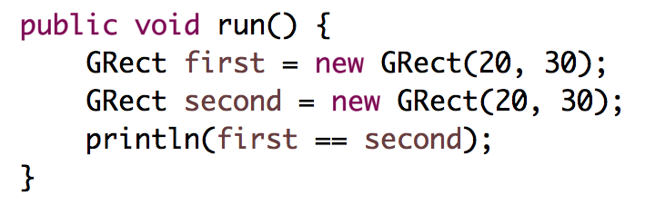
Practice
Does this print out true or false?
first.equals(second) would be true
Notes:
Prints false!

Slide 109
Practice – Chapter 3: Twins

Slide 110
Practice
public void run() {
int x = 5;
int y = x;
y += 2;
println(y);
println(x);
}
What is printed out?
Notes:
7
5

Slide 111
Practice
public void run() {
GOval oval = new GOval(0, 0, 50, 50);
oval.setColor(Color.PINK);
GOval oval2 = oval1;
oval2.setColor(Color.BLUE);
add(oval2);
add(oval);
}
What colors are oval and oval2?
Notes:
Both blue

Slide 112
Practice – Chapter 4: Leaving the Nest

Slide 113
Practice
public void run() {
int x = 2;
addFive(x);
println(x);
}
private void addFive(int num) {
num += 5;
}
What is printed out?
Notes:
2
(could return modified value)

Slide 114
Practice
public void run() {
GRect rect = new GRect(0, 0, 50, 50);
rect.setColor(Color.PINK);
makeBlue(rect);
add(rect);
}
private void makeBlue(GRect box) {
box.setColor(Color.BLUE);
}
What color is rect?
Notes:
Blue!

Slide 115
Primitives vs. Objects
Primitives store their actual values. Objects store their locations.
This affects how your code behaves!

Slide 116
getElementAt
getElementAt returns a reference to an object.
GRect rect = new GRect(0, 0, 50, 50);
add(rect);
...
GObject obj = getElementAt(25, 25);
println(obj == rect);
Heap
Stack
1024
rect
x = 0
y = 0
width = 50
height = 50
See location 1024
This prints true!
obj
See location 1024
Notes:
true

Slide 117
One-Pager: Stack/Heap
int x = 27;
int y = x;
GRect rect = new GRect(0, 0, 50, 50);
Grect box = rect;
In Java, new means create something in heap memory!
This slide is for curiosity only. Not required!
Stack
Strings are weird! Their variables store addresses to a special section of the heap. Detailed explanation on Piazza :)
Heap
x
27
y
0x400
27
x = 0
y = 0
width = 50
height = 50
1024 == 0x400 (base 16!)
rect
See location 1024
obj
See location 1024
Computer addresses use base 16

Slide 118
Plan for Today
Review: events and instance variables
A Boolean Aside
Memory
Revisiting Whack-A-Mole
Midterm tips

Slide 119
Revisiting Whack-A-Mole
Let’s revisit our Whack-A-Mole program to add some new functionality using what we just learned.

Slide 120
Plan for Today
Review: events and instance variables
A Boolean Aside
Memory
Revisiting Whack-A-Mole
Midterm tips

Slide 121
Midterm
Study strategies, in order of exam relevance
Sleep well for at least two days beforehand!
Do the practice exams under timed conditions
(Re-)do section problems from all handouts
Code up programs we wrote in lecture
Review lecture slides
Do CodeStepByStep practice problems
Read the textbook

Slide 122
Midterm
Strategies for taking the exam
Read over all the problems first
Seriously, I always have students who run out of time because they got stuck on one problem
If you don’t know exactly how to do something, write something approximate
If your syntax isn’t too far off, we’ll allow it
More importantly, it gets you unstuck so you can keep writing correct parts of the solution

Slide 123
Midterm
Methods that might be helpful
Integer.parseInt: converts String to int
Example: int x = Integer.parseInt(“27”);
useDelimiter: tells a Scanner to split on a specified String rather than on whitespace
Example: String line = “a,b,c”;
Scanner tokens = new Scanner(line);
tokens.useDelimiter(“,”);
println(tokens.next()); // prints “a”

Slide 124
Recap
Review: events and instance variables
A Boolean Aside
Memory
Revisiting Whack-A-Mole
Midterm tips
Good luck on the midterm!

